Slide 1
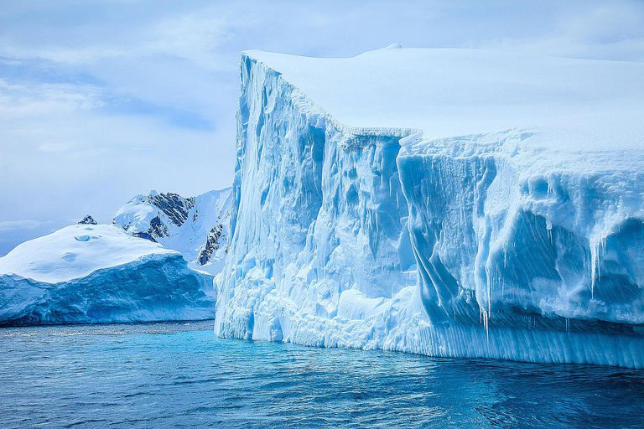


Non smooth dynamics and tipping in climate models
Chris Budd OBE, Rachel Kuske, Susan Morupisi
Warwick, May 2025

Slide 2
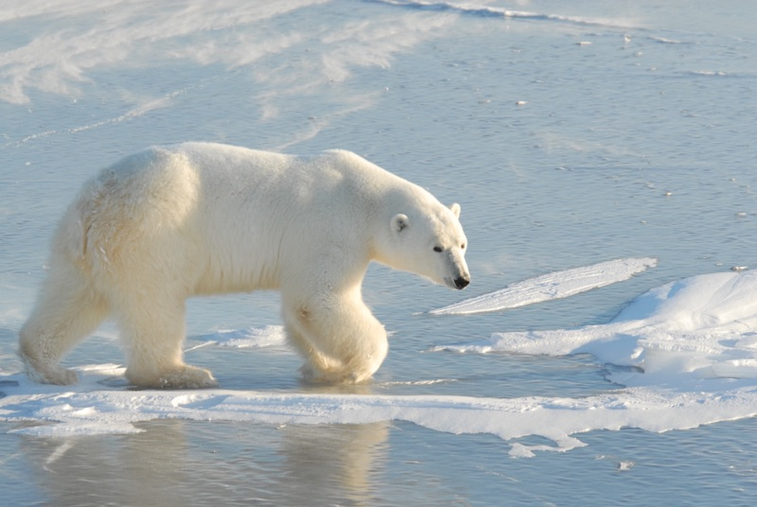
Can we predict the climate?
Method 1: (The IPCC way)
Construct a very sophisticated model
Solve on a super computer
Only works for short (100 year) prediction periods
Method 2: (The mathematicians way)
Construct reduced climate models for long term qualitative and quantitative predictions

Slide 3
All climate models are based on (stochastic) mathematics, coupled with physics, chemistry, biology, astrophysics, ..
GCM: Global models of climate change. Complex with millions of lines of code. Look at whole Earth, oceans and atmosphere. Effective for precise predictions over decades.
EMIC: Less complex intermediate models of the physics. Treat Earth as a series of boxes. Make predictions over much longer periods. Useful to test models, verify GCM predictions, predict ice ages
EBM: Simplest models. Treat Earth as a single point. Look at balances of energy, albedo and other effects. Good for sensitivity calculations

Slide 4
EMICS: Typically low-dimensional dynamical systems
A. Classical smooth dynamical systems:
Smooth evolution. Hopf/cyclic fold/saddle-node bifurcations, and smooth tipping points for transitions
B. Non-smooth dynamical systems and relaxation oscillators:
Switches and very different time-scales for the evolution. Grazing bifurcations, non-smooth folds and non-smooth tipping points for transitions.

Slide 5

Will look at two non-smooth EMICS
Models of the ice ages
Models of tipping in the thermohaline circulation in the North Atlantic

Slide 6
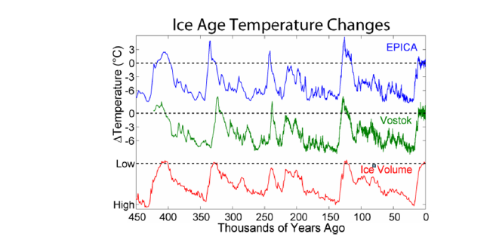
1. The 100 kyr periodicity in the ice ages

Slide 7
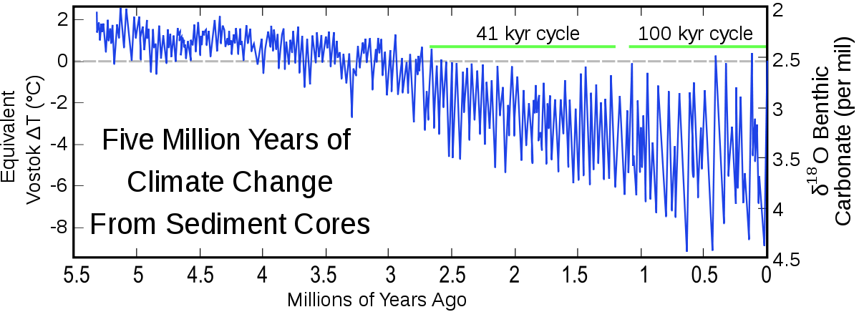
Mid Pleistocene Transition (MPT):
Change in frequency one million years ago
[Wikipedia]

Slide 8
QUESTIONS
What causes the 100kyr periodicity in the ice ages?
What caused the MPT?

Slide 9
The factors which make up an ice age
Variations in solar forcing
Increase in sea ice
Increase in glaciers
Changes in Carbon Dioxide
Changes in temperature
Continental drift
Coupling of all of the above

Slide 10
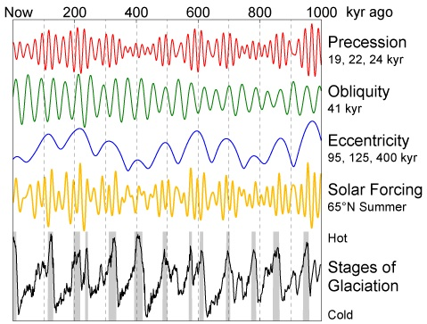
Solar forcing I₆₅(t) varies due to Milankovich cycles

Slide 11
Issues:
19kyr, 23kr, 41kyr: I₆₅ (t) cycles all significant
implying linear forcing before the MPT
2. 95kr eccentricity variation: very small forcing!!
Q. Is the recent 100kyr glacial cycle
Externally Forced by the eccentricity changes: Unlikely!
Independent of these changes and instead caused by an Internal climate variation which also has a 100kyr period
C. Internal weakly synchronised by harmonics of the cycles

Slide 12
Smooth. [Saltzman + Maasch 90,91] Carbon Cycle model
V: Ice mass
T: Deep ocean temperature
C: CO₂ S(t): I₆₅(t)
Parameters CHOSEN to give 100 kyr cycle
CO₂ Tectonic plate forcing

Slide 13
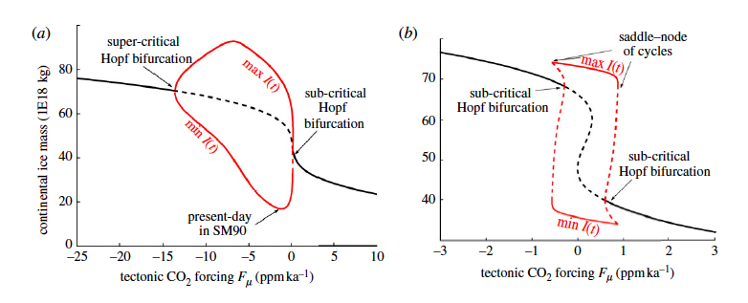
Predicts: Hopf bifurcation as an explanation for the MPT
Bifurcation occurs due to a slow variation in CO₂ forcing
Linear regime before MPT (forced)
Nonlinear regime after MPT (synchronised)
But …. Crucial CO₂ equation very contrived! No real justification!

Slide 14
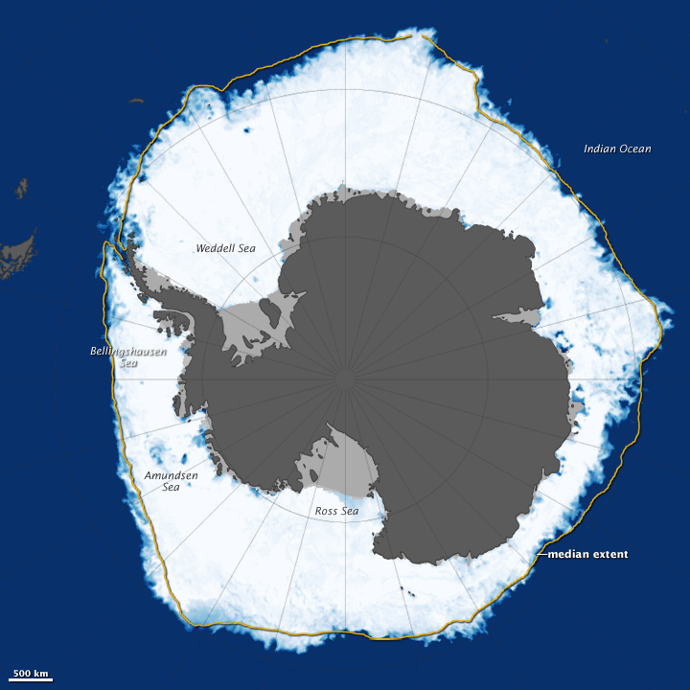
Non-Smooth: PP04 Transition Model
[Paillard and Parrenin 04], [Morupisi + B 20,21]
V: Ice volume A: Antarctic Ice C: Carbon Dioxide
Sudden release of CO₂ when ocean stratification becomes unstable

Slide 15
Glacial: Carbon Dioxide absorbed into the ocean
Sudden CO₂ ventilation occurs when deep ocean stratification ceases to be stable
Release of Carbon Dioxide leads to Warming of the Earth which drives a rapid Deglaciation process
System relaxes to a cooler steady state after the release

Slide 16
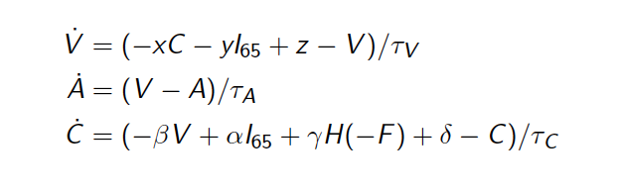
Heavyside function
V: Ice volume A: Antarctic Ice C: Carbon Dioxide
Stratification parameter or Salt water formation efficiency

Slide 17
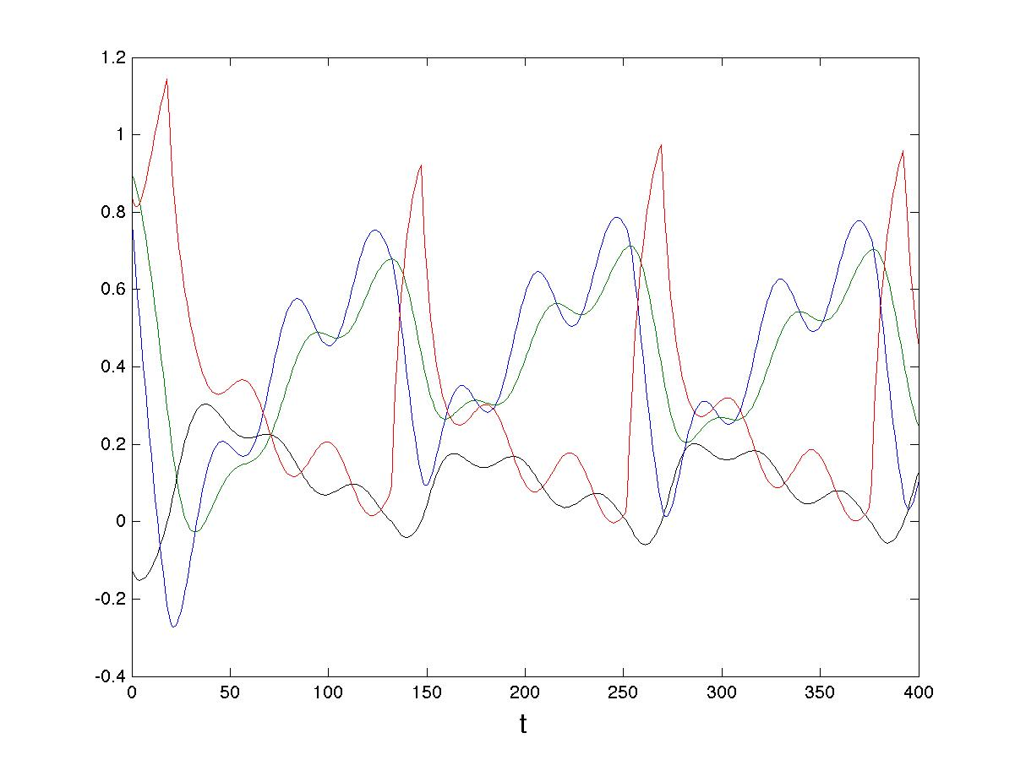
Typical solution
C
V
A
F

Slide 18
PP04 is a non-smooth discontinuous Filippov System
Glacial
Inter Glacial
Switching manifold

Slide 19
Typical ‘transverse’ intersection

Slide 20
Unforced system
Fixed points
Physical
Virtual

Slide 21
Theorem
There exist critical values of the parameter d
If interglacial state is physical and globally attracting
If glacial state is physical and globally attracting
If see a periodic solution
Transitions occur at Border Collision Bifurcations when

Slide 22
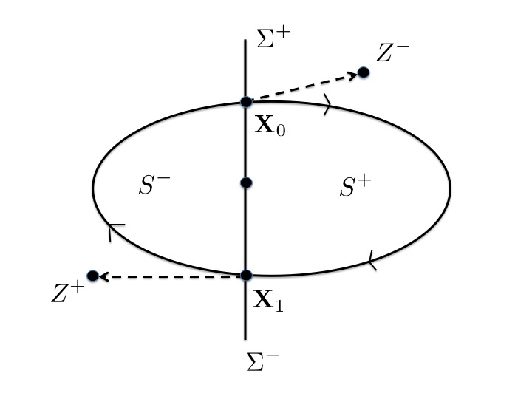
Existence of a periodic orbit
Virtual
F(X) > 0
F(X) < 0
Virtual
: F(X) = 0
Proof using the Brouwer Fixed Point. theorem

Slide 23
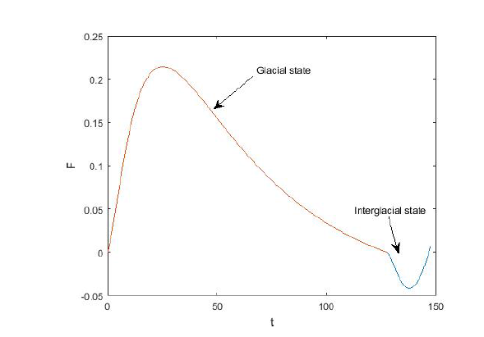
Periodic solution Period T = 147 kyr
Frequency

Slide 24
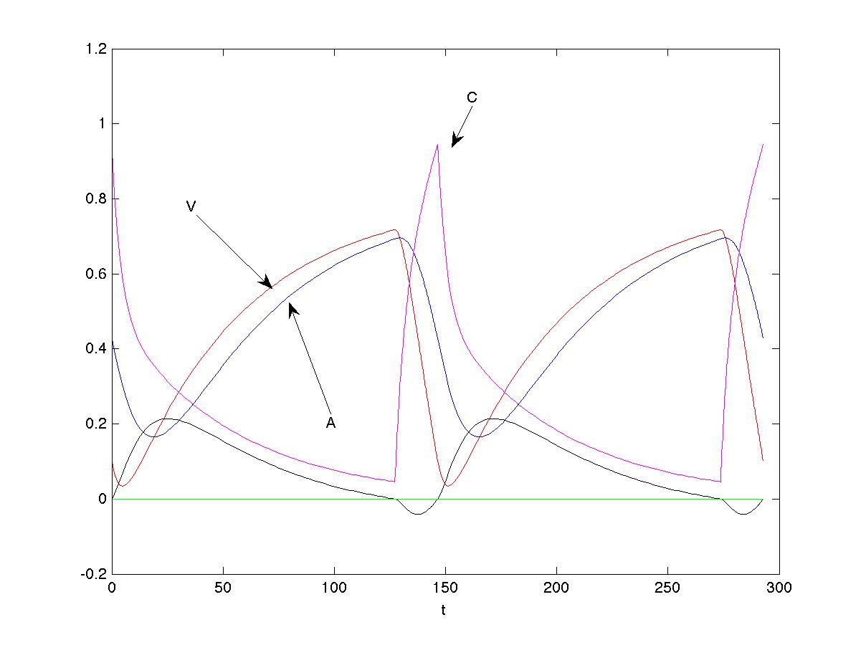
Periodic Solution: Period T = 147 years

Slide 25
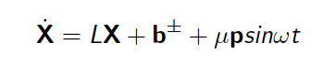
Periodically Forced System
There exist: (m,n) synchronised periodic solutions
m: glacial cycles
n: forcing cycles period =

Slide 26
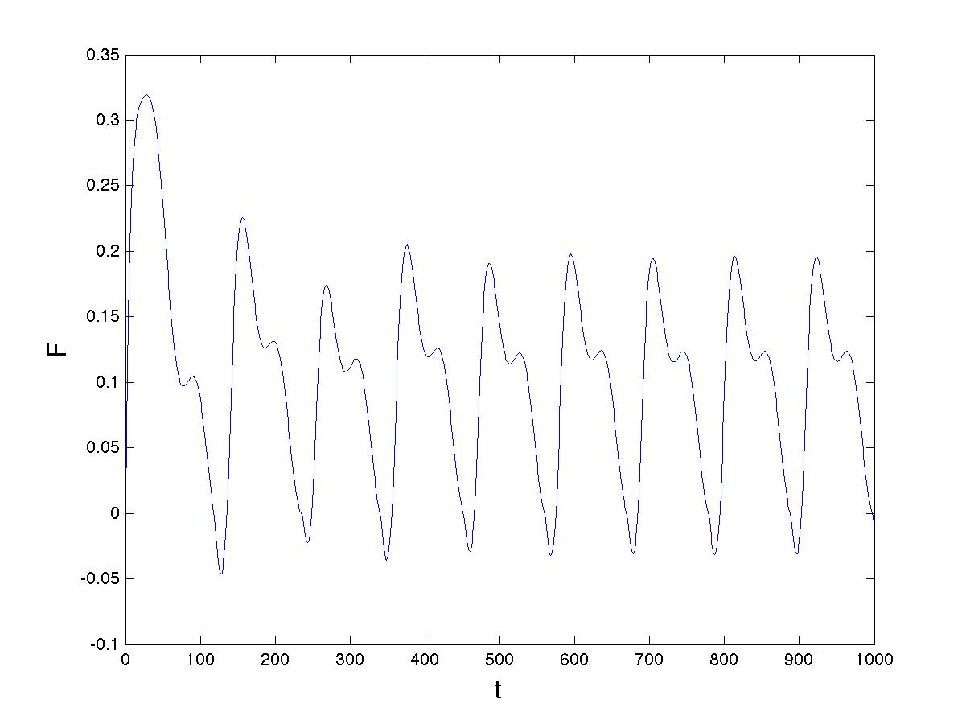
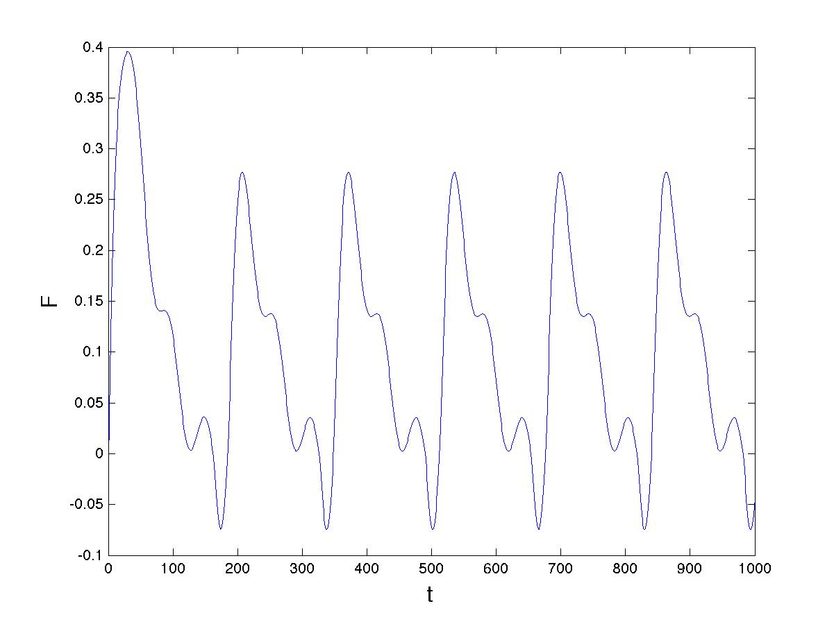
(1,2) periodic orbit
(1,3) periodic orbit

Slide 27
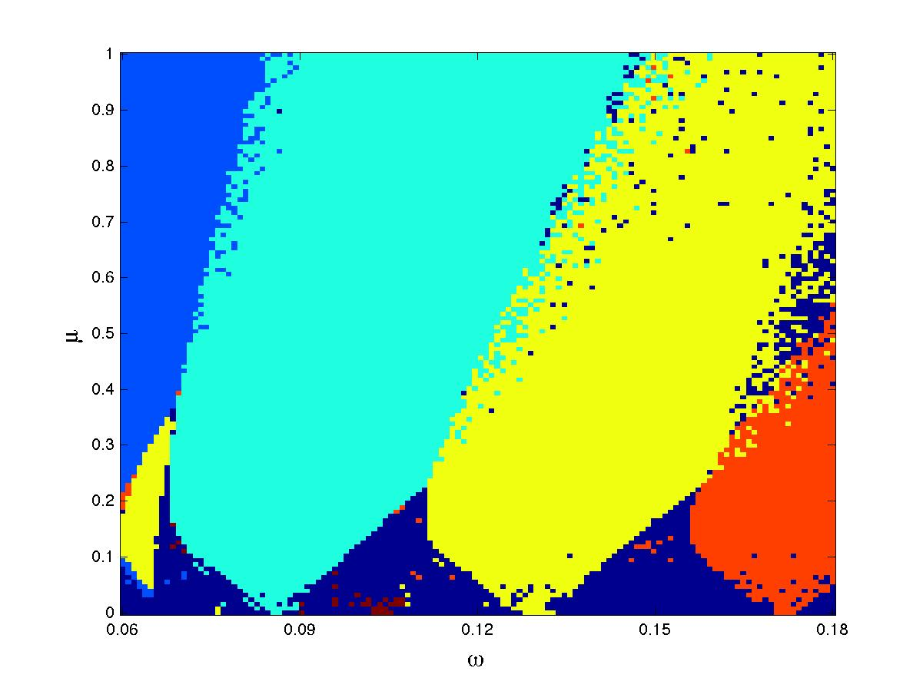
Regions of existence
(1,1)
(1,2)
(1,3)
Physical values
(1,4)
(2,5)

Slide 28
Algebraic Conditions for a (1,n) periodic orbit:
Physical if:

Slide 29
Small 𝜇
Look for (m,n) periodic solutions which are perturbations of the unforced periodic solution

Slide 30
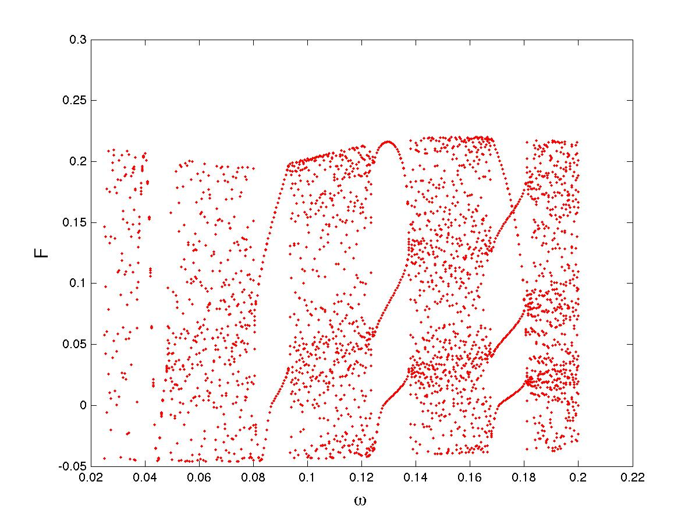
Small
(1,1)
(1,3)
(1,4)
QP
(1,2)

Slide 31
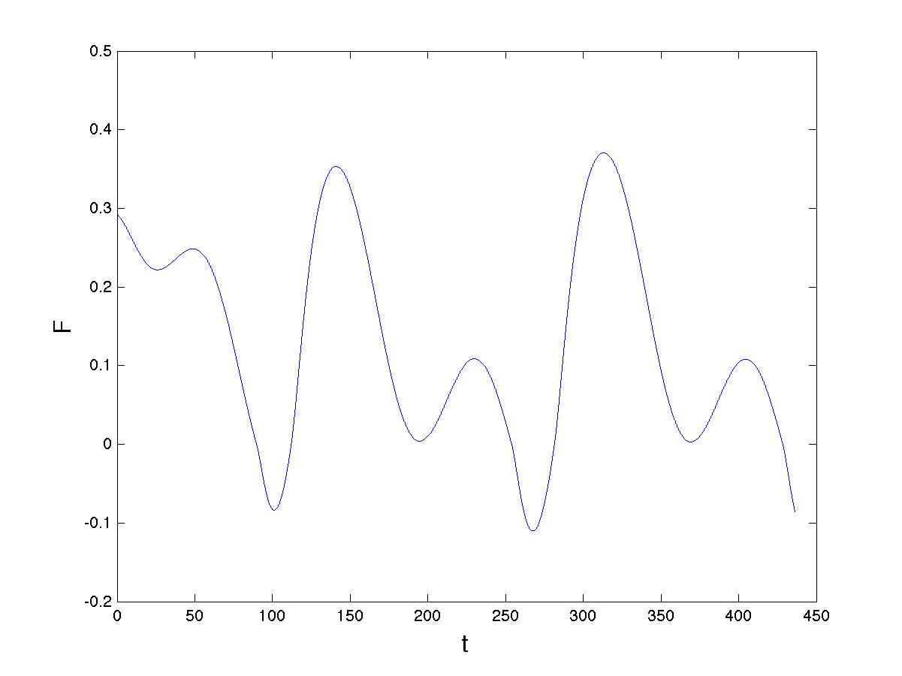
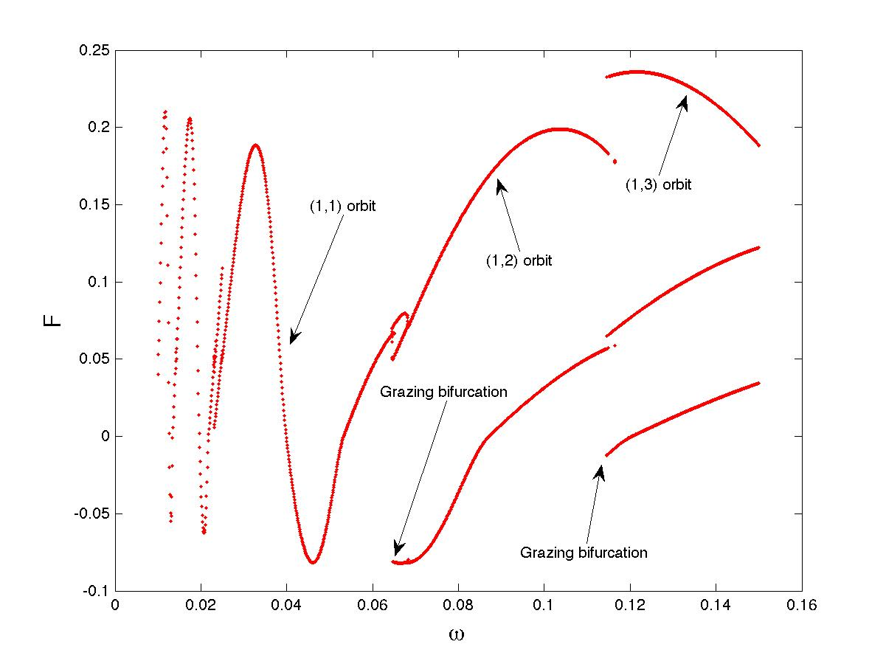
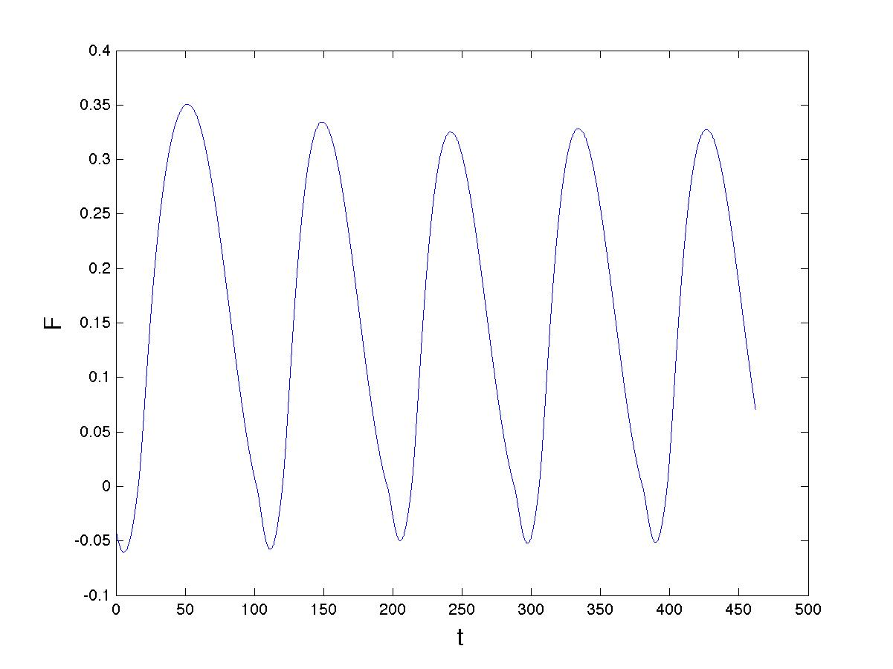
Physical

Slide 32
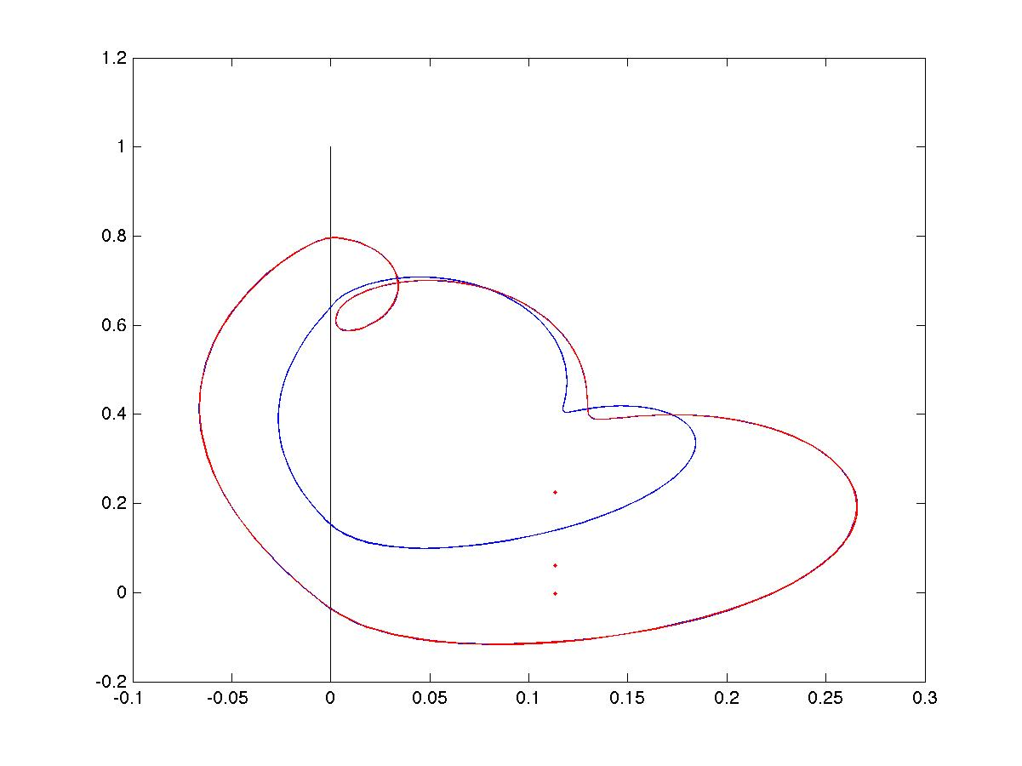

Slide 33
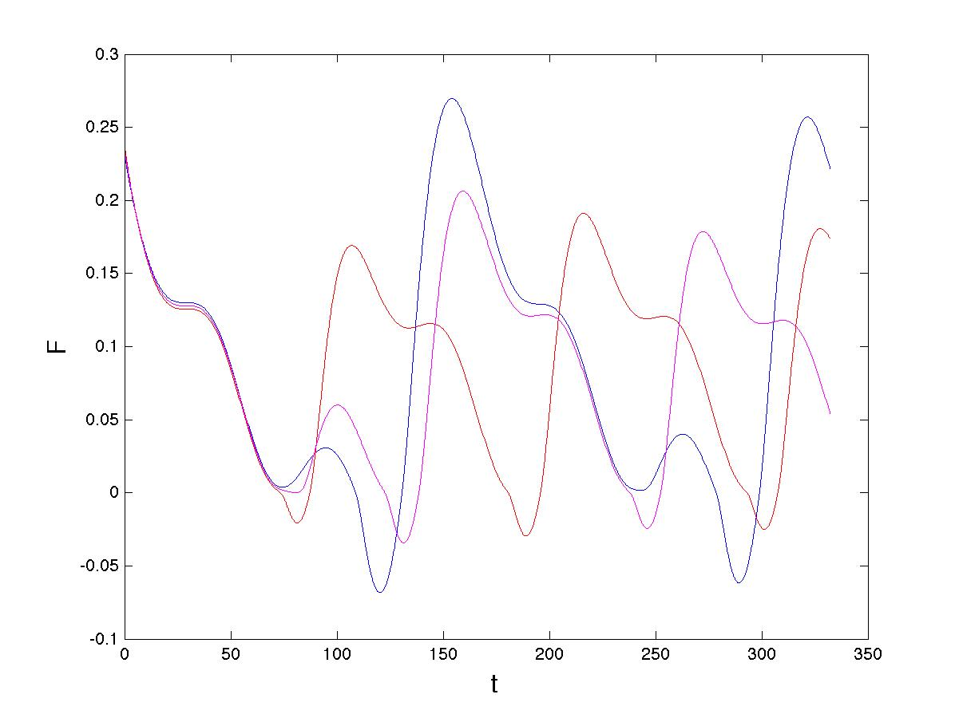
Grazing transition
(1,3)
(1,2)
graze

Slide 34
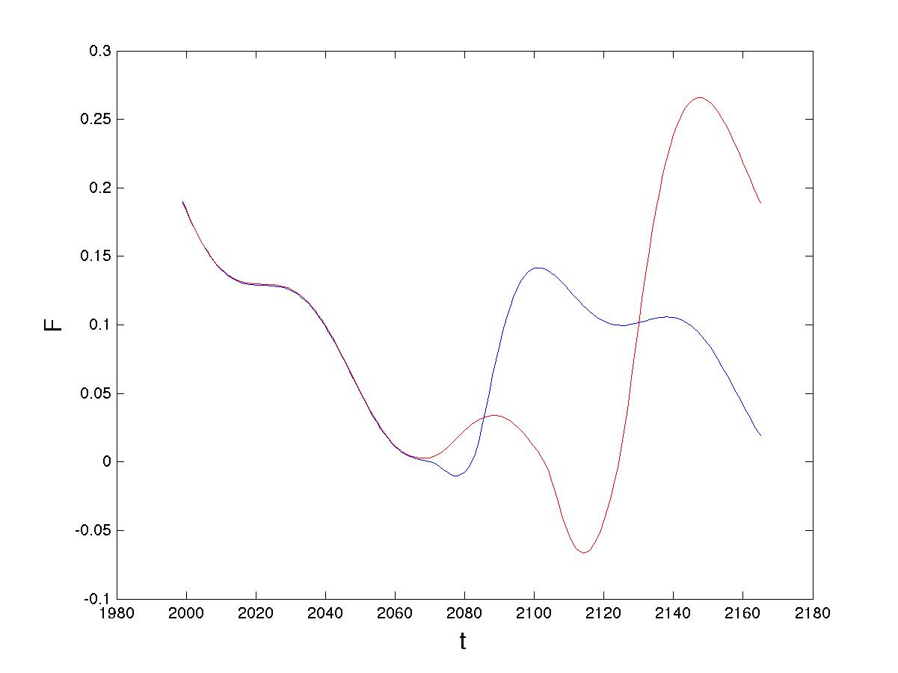

Slide 35
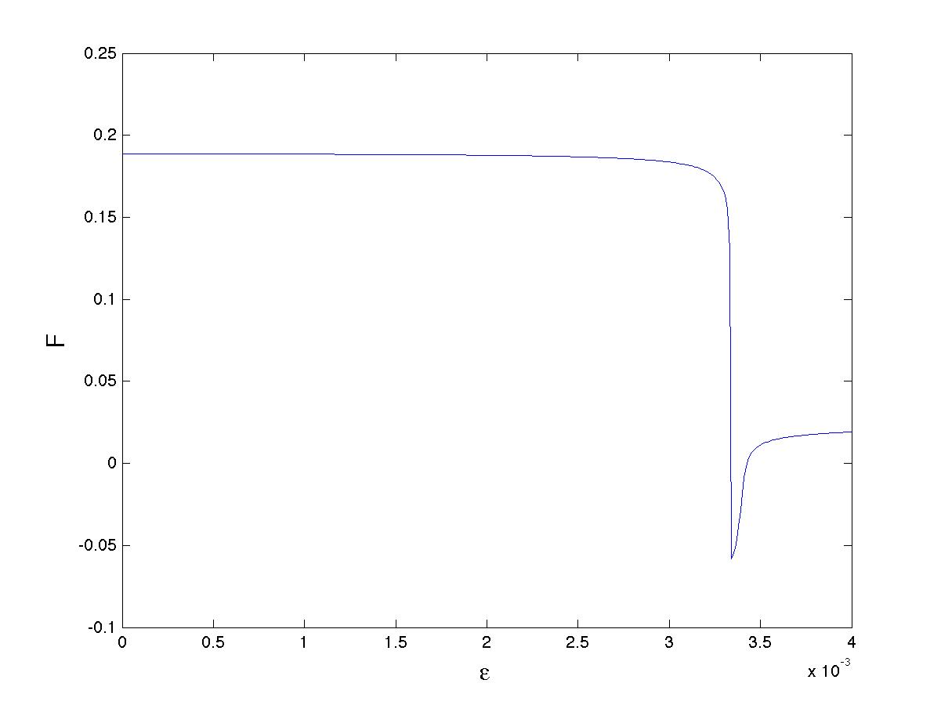
Grazing map
Poincare Map:
Smoothed discontinuity
Locally square-root behaviour

Slide 36
Local form of the Grazing Poincare Map
Introduces very significant stretching to the phase space
Leads to large transitions between states under small perturbations

Slide 37
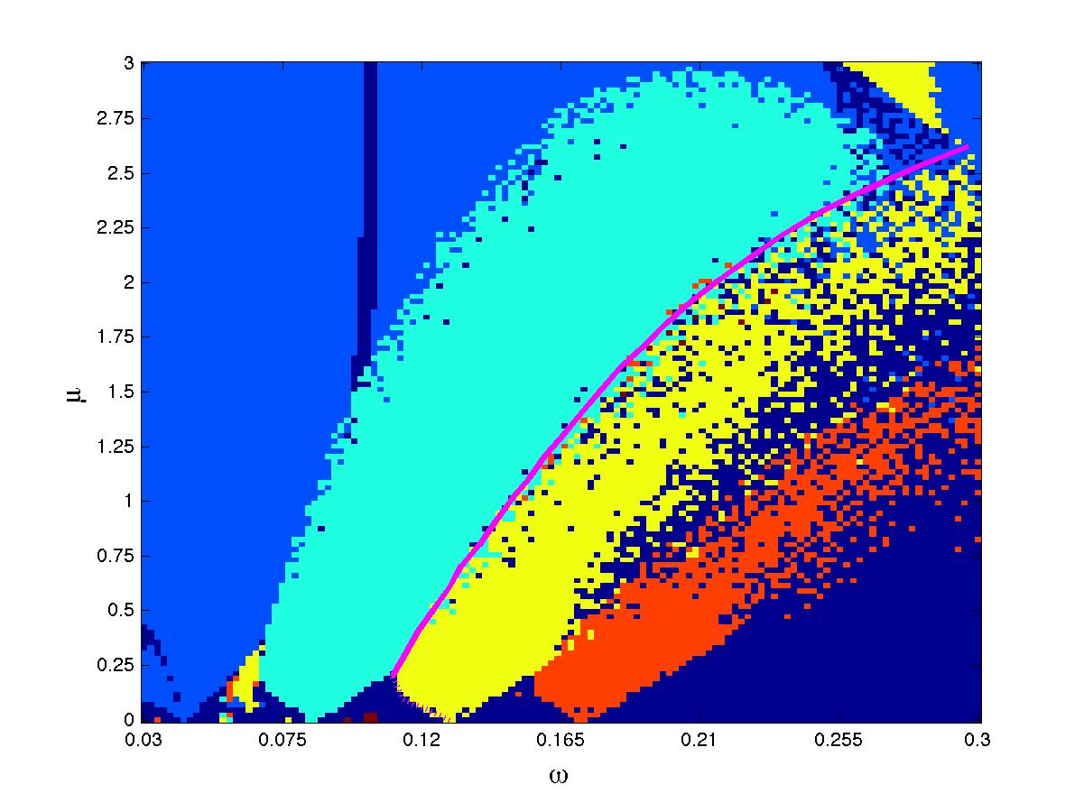
(1,1)
Grazing
line
(1,2)
(1,3)
(1,4)
QP
Grazing is the DOMINANT form of transition between states

Slide 38
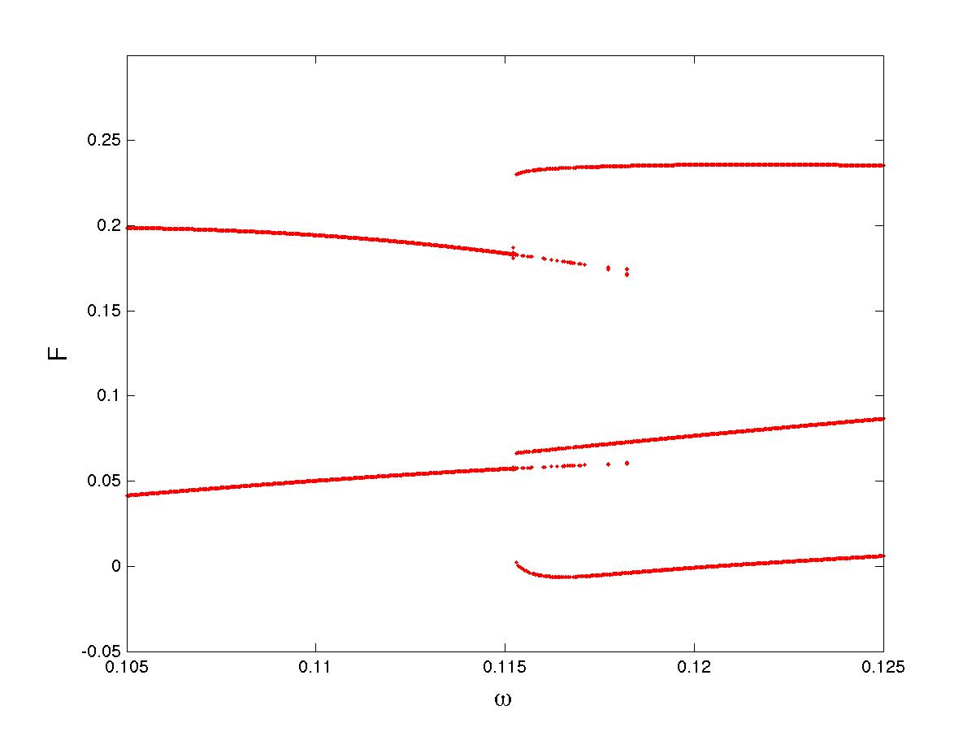
Coexistence of period 2 and period 3
(1,2) periodic orbit
(1,3) periodic orbit

Slide 39
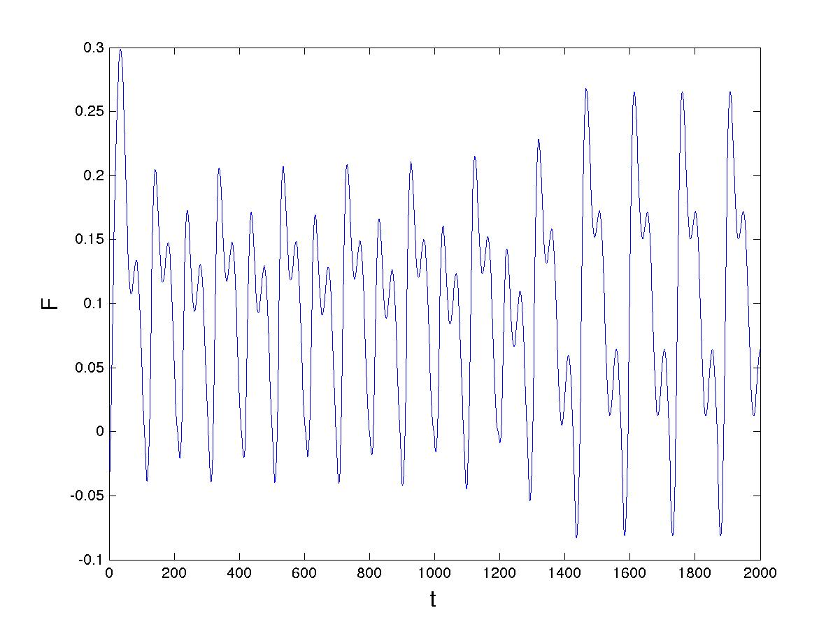
(1,3)
(2,4)
Graze
Transition similar to the MPT

Slide 40
Links to climate
Milankovich forcing has dominant term of 41 kyr period which in non dimensional units has
For these values there exists a very stable (1,3) periodic orbit of period T = 123 kYr
Orbit persists when extra terms are added to the forcing

Slide 41
Regions of existence
(1,1)
(1,2)
(1,3)
Physical values
(1,4)
(2,5)

Slide 43
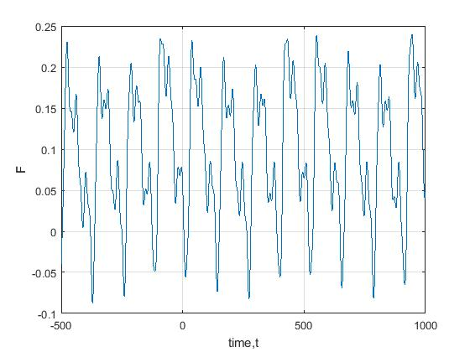
PP04 model with quasi-periodic forcing
Observations

Slide 44
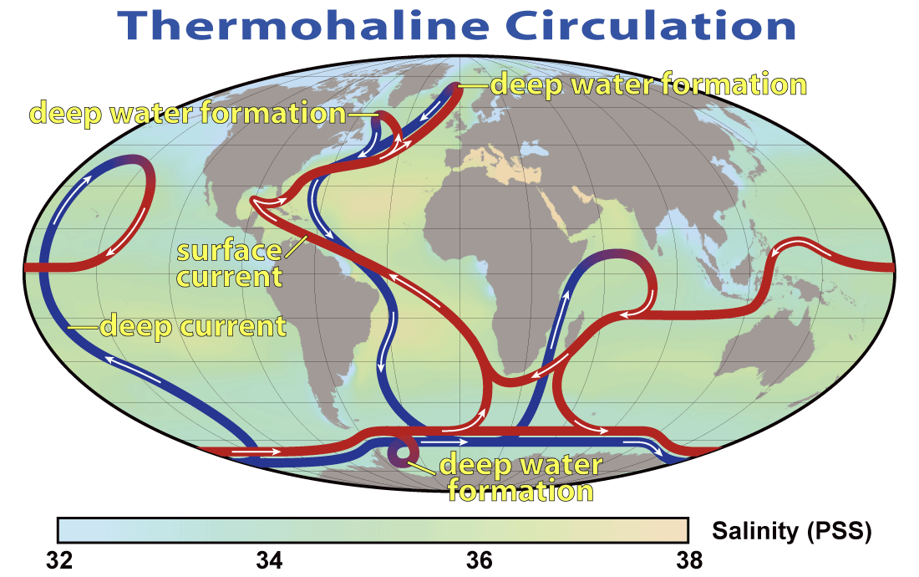
2. Tipping in non-smooth models of AMOC

Slide 45
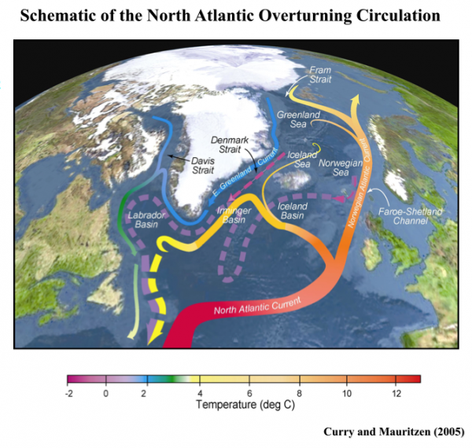
Do we see tipping in this system?

Slide 46
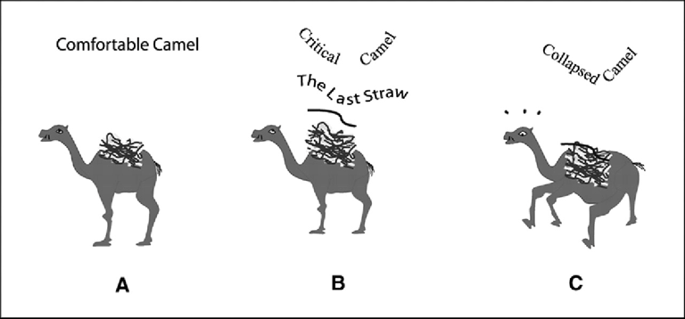
Tipping points
Arise in systems where small parameter changes can have large effects
Eg. The straw which broke the camel’s back!

Slide 47
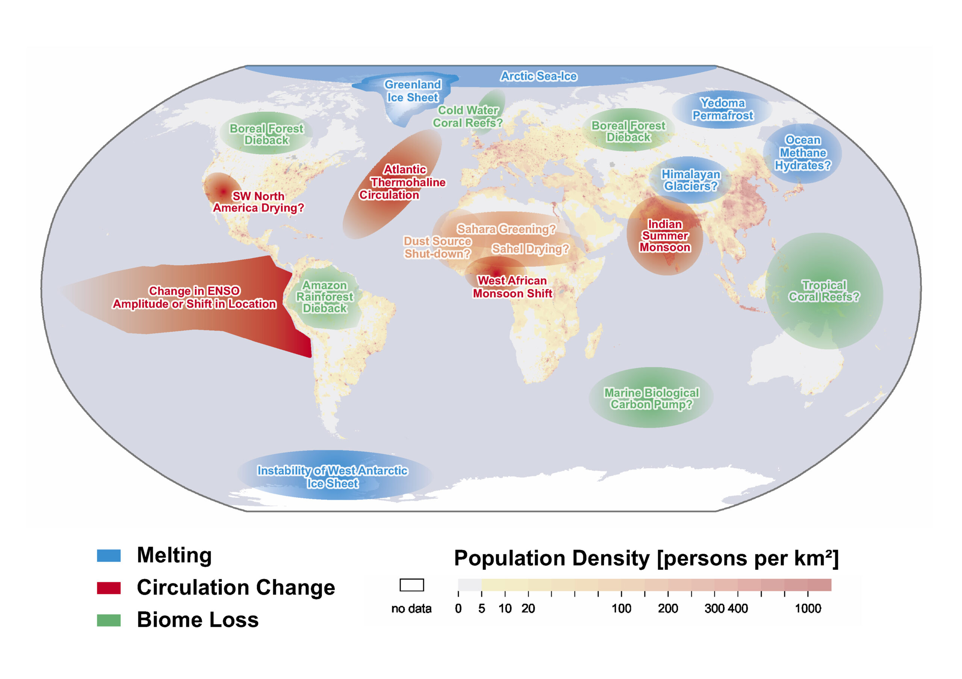
Climate tipping points [Lenton]

Slide 48
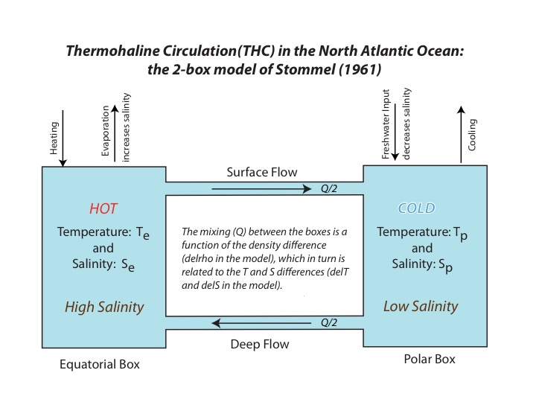
Non-Smooth Stommel 2-Box Model of Thermohaline circulation
[Stommel 61, Dijkstra 2014, Kuske + B 2021,24]
T = T_{e} – T_{p} S = S_{e} - S_{p}

Slide 49
Model as a non-smooth system
Freshwater forcing
Second derivative jump on manifold:

Slide 50
Model as a non-smooth system
Freshwater forcing
Second derivative jump on manifold:

Slide 51
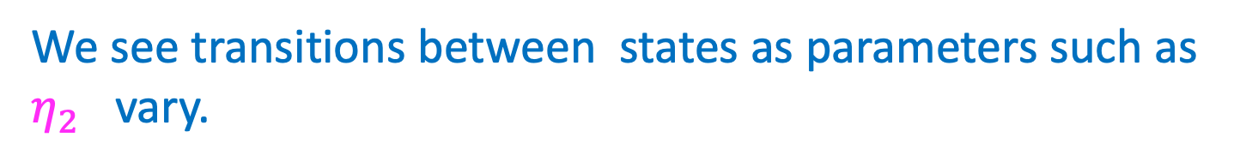

We see transitions between states as parameters such as $η_{2}$ vary.
Saddle, Node, Focus. Saddle-Node at
Node only
Saddle and Focus coalesce when
Non-Smooth Fold (NSF) Saddle-Focus Bifurcation.
Leads to novel NSB-tipping behaviour as $η_{2}→ η_{1}η_{3}$

Slide 52
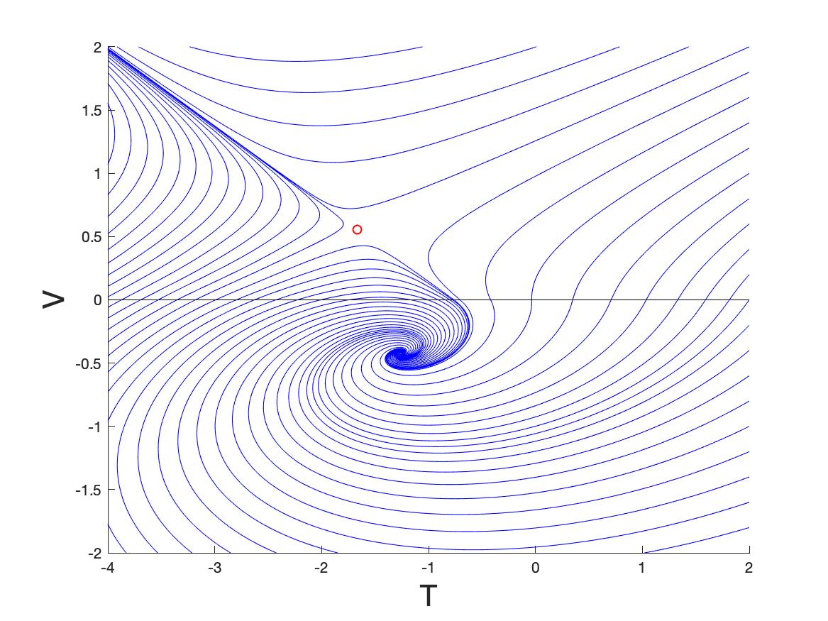
(T,V) phase plane close to the non-smooth fold
Saddle-Focus
Stable node
saddle
focus

Slide 53
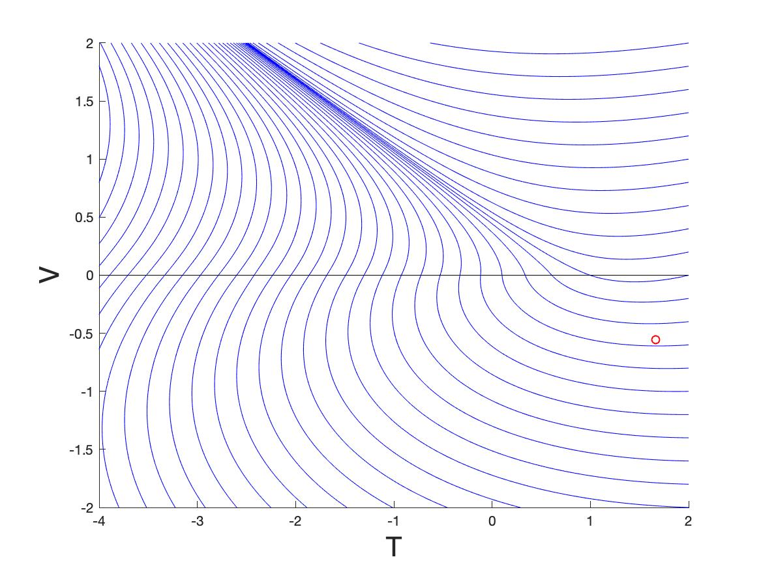
Stable node
Only node is stable

Slide 54
Tipping close to the non-smooth fold for slowly varying
Temperature dominated
Node
NSF-Tipping
V = T - S
Saddle-Node
Non-smooth fold
Saddle
Focus
Salinity dominated

Slide 55
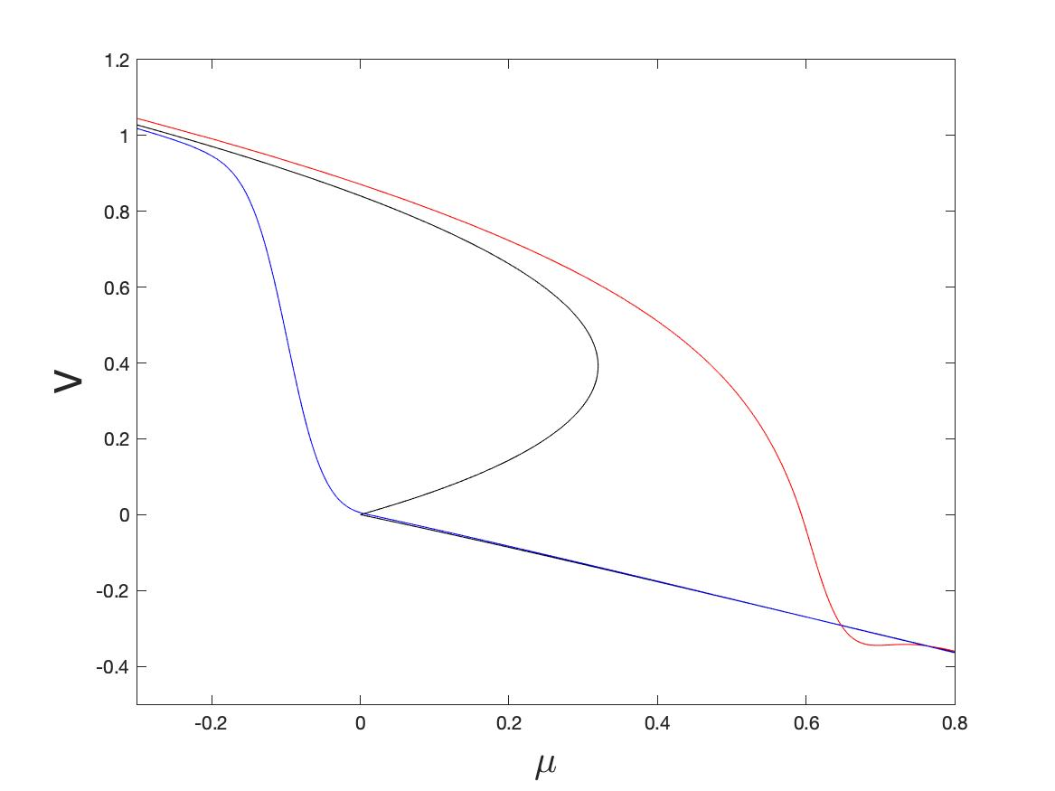
SNB Tipping
Temperature to salinity
NSF Tipping
Salinity to temperature
Non-smoothness leads to more rapid tipping

Slide 56
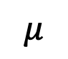
0
$$μ$$
0.5
Seasonal variation advances tipping

Slide 57
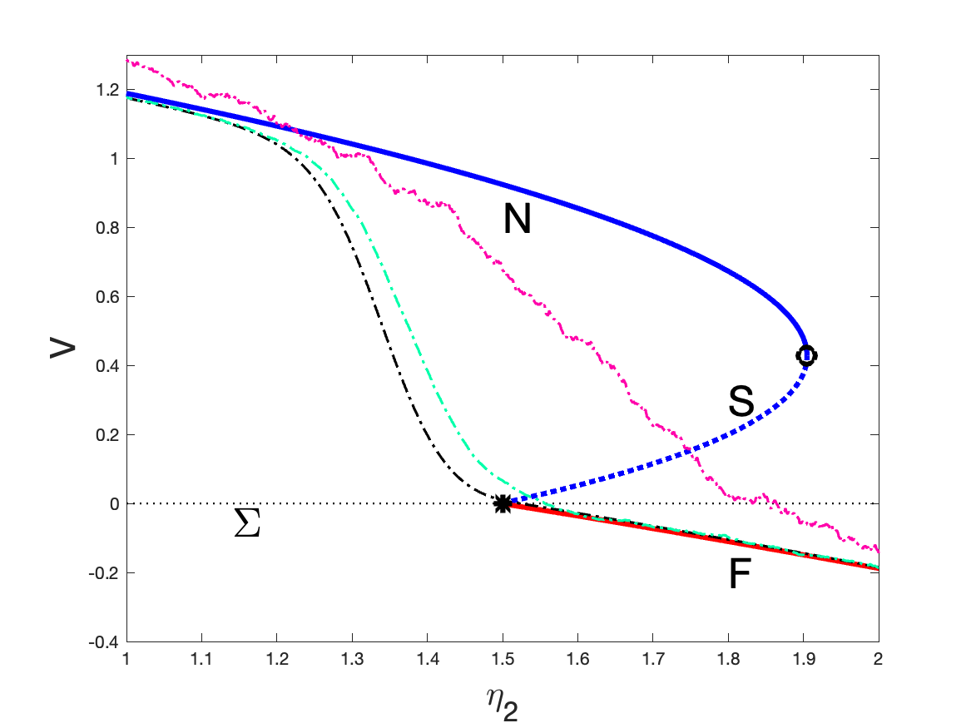
0
$$μ$$
0.5
Noise advances tipping

Slide 58
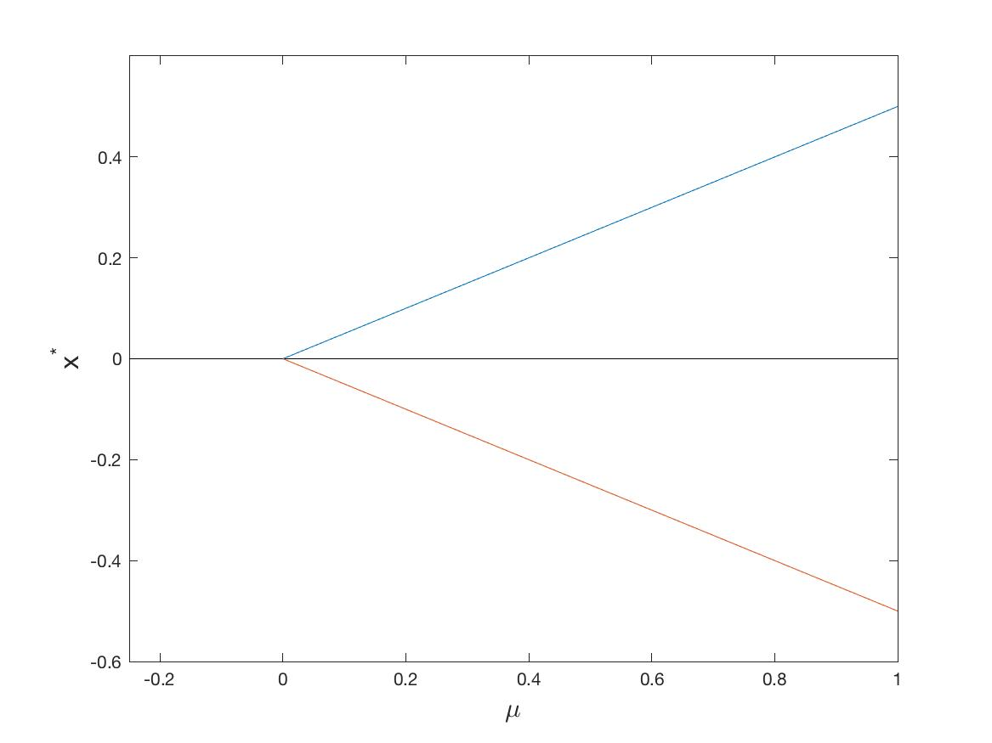

Simplified one-dimensional non-smooth system
Non-smooth fold
Unstable
Fixed points:
$$μ=0$$
Stable

Slide 59
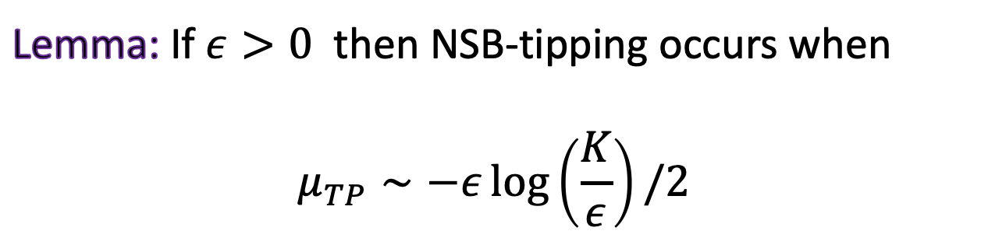

Case 1: Slow parameter drift
Define ‘non-smooth’ tipping to occur at:
$μ= μ_{TP }$ when $x\left(t\right)=K≫1$
Lemma: If $ε>0$ then NSB-tipping occurs when
$$μ_{TP}∼−ε\log\left(\frac{K}{ε}\right)/2$$

Slide 60
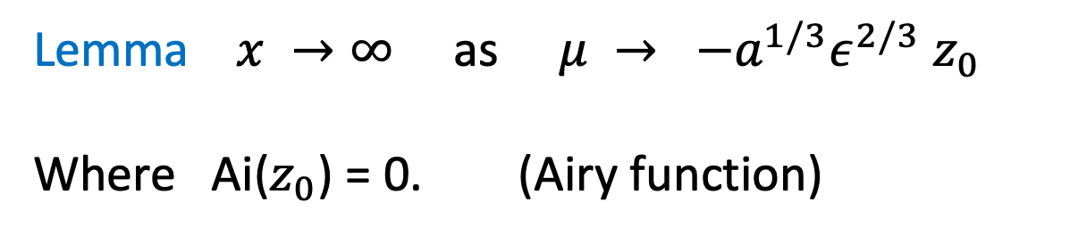
Comparison with a SNB
Lemma $x →∞$ as $μ → {−a^{1/3}ε}^{2/3}$ $z_{0}$
Where Ai($z_{0}$) = 0. (Airy function)

Slide 61
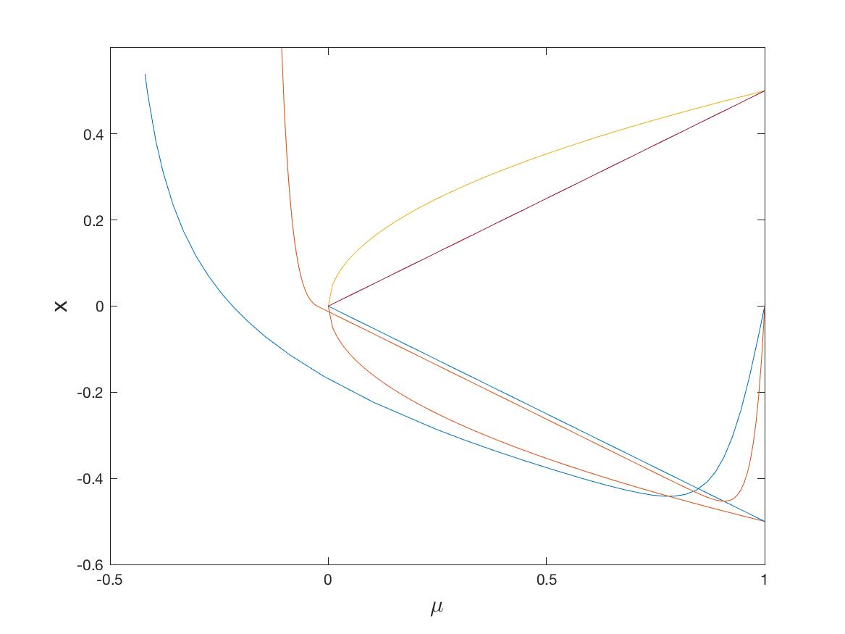
Comparison between smooth and non-smooth tipping
Smooth systems tip later than non smooth ones!

Slide 62
Conclusions
Stommel 2-box model has very rich
dynamics, lots still to do
This includes tipping at a non-smooth fold (NSF)
Non-smooth tipping occurs earlier than ‘smooth tipping’ and is much more sensitive to noise and oscillatory effects, which advance it significantly
It is also harder to detect as there is no slowing down
This could have profound implications in climate modelling!

